Slide 1

Note: The data and information in this document is reflective of a hypothetical situation and client. This document is to be used for KPMG Virtual Internship purposes only.
Sprocket Central Pty Ltd
Data analytics approach
David de la Iglesia
Data Analytics Consulting Virtual Intern

Slide 2
Note: The data and information in this document is reflective of a hypothetical situation and client. This document is to be used for KPMG Virtual Internship purposes only.
Agenda
Introduction
Data Exploration
Interpretation

Slide 3
Note: The data and information in this document is reflective of a hypothetical situation and client. This document is to be used for KPMG Virtual Internship purposes only.
Introduction
Problem Statement:
Sprocket Central Pty Ltd is a long-standing KPMG client whom specializes in high-quality bikes and accessible cycling accessories to riders. Their marketing team is looking to boost business by analyzing their existing customer dataset to determine customer trends and behavior.
About Dataset:
Using the existing 3 datasets:
Customer demographic
Customer address
Transactions
Our goal:
Sprocket Central Pty Ltd has given us a new list of 1000 potential customers with their demographics and attributes. However, these customers do not have prior transaction history with the organisation.
The marketing team at Sprocket Central Pty Ltd is sure that, if correctly analysed, the data would reveal useful customer insights which could help optimise resource allocation for targeted marketing. Hence, improve performance by focusing on high value customers.

Slide 4
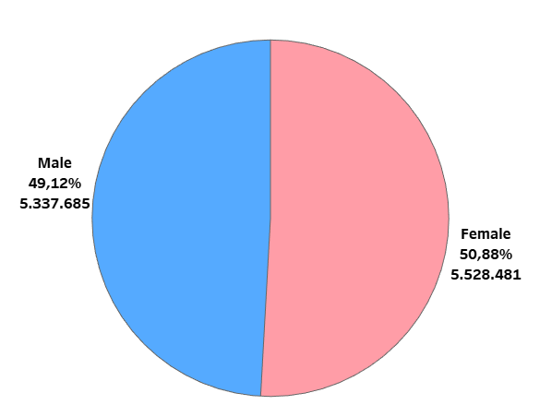
Note: The data and information in this document is reflective of a hypothetical situation and client. This document is to be used for KPMG Virtual Internship purposes only.
Data Exploration
Total Profit based on different Age Groups
Men own 49.12% of total profits compared to 50.88% for women.
Although women have a higher percentage, we do not consider this difference to be relevant when it comes to making business decisions.

Slide 5
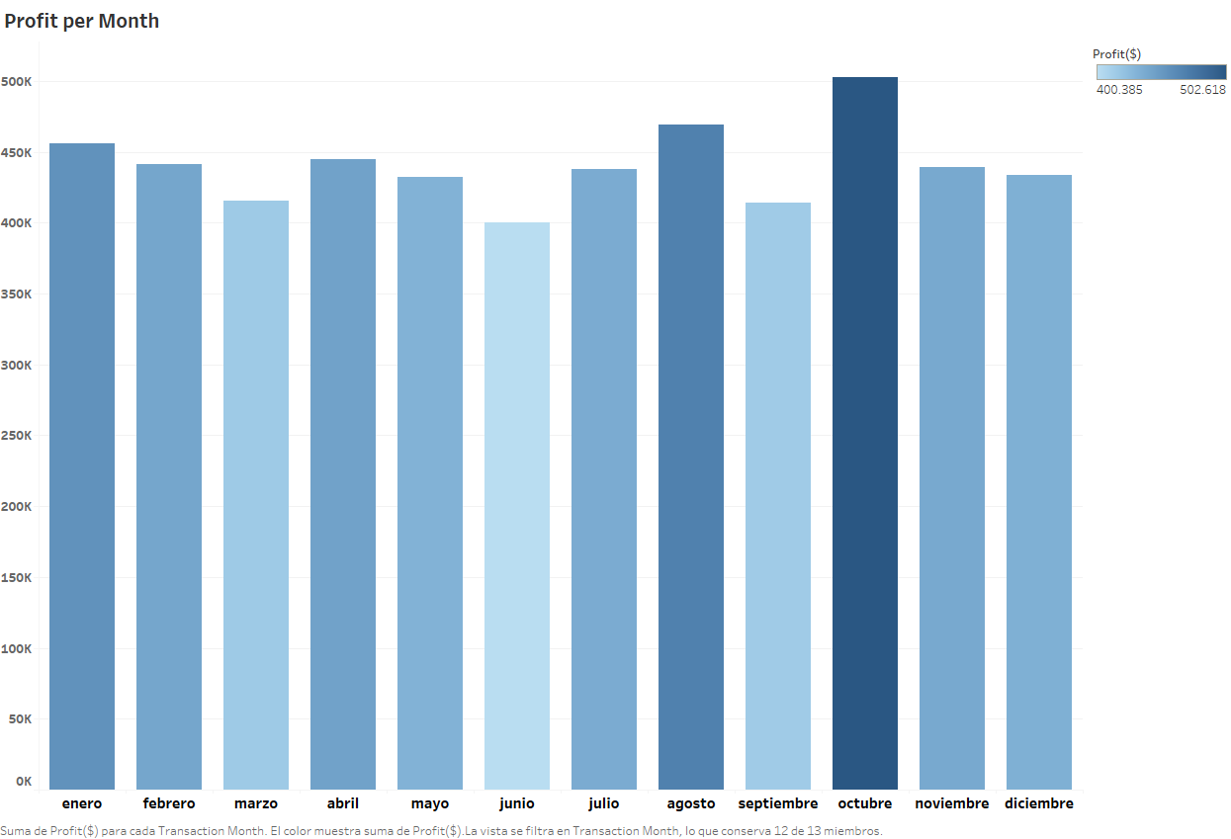
Note: The data and information in this document is reflective of a hypothetical situation and client. This document is to be used for KPMG Virtual Internship purposes only.
Data Exploration
Total Profit in the year 2017
The month with the highest profit was October, with $502,618.
Following this month were August and January with $469,245 and $456,239, respectively.

Slide 6
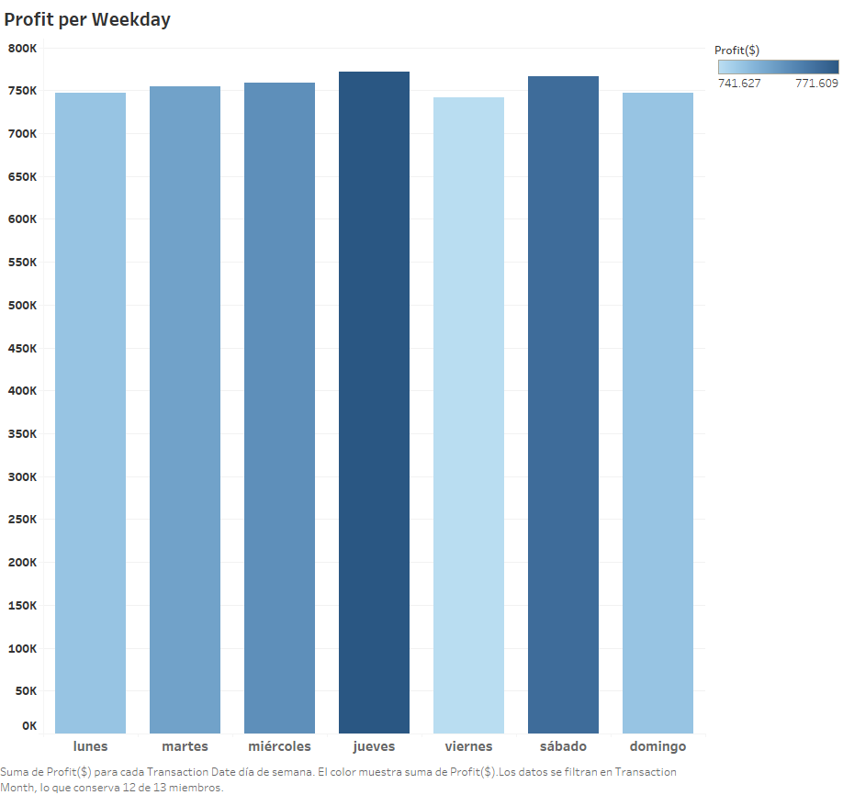
Note: The data and information in this document is reflective of a hypothetical situation and client. This document is to be used for KPMG Virtual Internship purposes only.
Data Exploration
Total Profit by weekday
The most profitable day of the week is Thursday, giving a profit of $771,609.
Second place goes to Saturday, with a profit of $766,762.

Slide 7
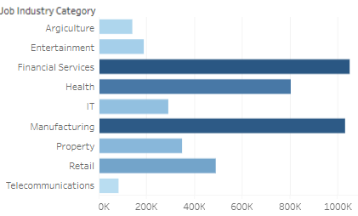
Note: The data and information in this document is reflective of a hypothetical situation and client. This document is to be used for KPMG Virtual Internship purposes only.
Data Exploration
Total Profit by Industry
The most profitable industries are financial, manufacturing and healthcare, respectively.

Slide 8
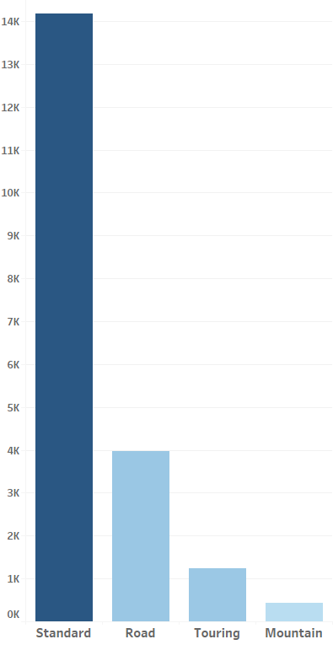
Note: The data and information in this document is reflective of a hypothetical situation and client. This document is to be used for KPMG Virtual Internship purposes only.
Interpretation
Total Sales by product
The most popular product is the standard product with 14,176 transactions and a profit of $8,138,950.

Slide 9
Note: The data and information in this document is reflective of a hypothetical situation and client. This document is to be used for KPMG Virtual Internship purposes only.
Interpretation
Recommendations for the marketing team
The difference by gender is minimal, so there is no need to create a campaign focused on any gender.
It is advisable to carry out a marketing campaign during Christmas and other important holidays, with December being below average in terms of profits.
Friday is the slowest day of the week, reducing the working day or having fewer workers may be a viable option.
Most of our clients live in the state of NSW and most of the new list also reside in that state.

